Slide 1
PROJECT TITLE SECURE DATA HIDING IN IMAGES USING STEGANOGRAPHS
CAPSTONE PROJECT
Presented By:YELLANURU NIVEDITHA
Student Name : YELLANURU NIVEDITHA
College Name & Department : SRI VENKATESWARA INSTITUTE OF
TECHNOLOGY & COMPUTER SCIENCE AND TECHNOLOGY

Slide 2
OUTLINE
Problem Statement
Technology used
Wow factor
End users
Result
Conclusion
Git-hub Link
Future scope

Slide 3
Problem Statement
A "secure data hiding in images using steganography" project aims to develop a system that can effectively conceal sensitive information within digital images, ensuring that the hidden data remains undetected while maintaining high quality in the modified image, often achieved by utilizing advanced encryption techniques and robust steganographic algorithms to protect the secret message embedded within the carrier image.
It can be design and implement a secure steganographic system capable of embedding sensitive data (text, images, audio) into a cover image without noticeable visual distortion, while incorporating robust encryption mechanisms to safeguard the hidden information from unauthorized access.

Slide 4
Technology used
Secure Data Hiding In Images Using Steganographs project used several technologes.Those are
Platform used by python: In the securely hide data within images using steganography in Python, the most common approach is to utilize the "Least Significant Bit (LSB)" technique, where the least significant bits of each pixel in the image are replaced with the bits of the secret message, allowing for near-invisible data embedding while maintaining image quality.
Library used on cv2: The cv2 is used for computer vision tasks like image processing, video analysis, and object detection. The LSB of each pixel in the image, embedding the secret data bit by bit into these LSBs, making the changes nearly imperceptible to the human eye. It converting the secret data into binary and replacing the LSBs of the image's colour channels with the corresponding binary bits.
Software Used by operating system: It used in project as operating systems like Os to run their code editor and interact with the necessary tools, allowing them to write, compile, and execute their programs without directly managing low-level hardware details; the OS handles resource allocation, file management, and other system functions, providing a user-friendly environment for coding.
Operater used in string: The string work To hide data refers to techniques where sensitive information is stored within a seemingly normal string of characters, often using encryption or encoding methods to mask the actual data, making it difficult for unauthorized users to decipher it when viewing the code directly.

Slide 5
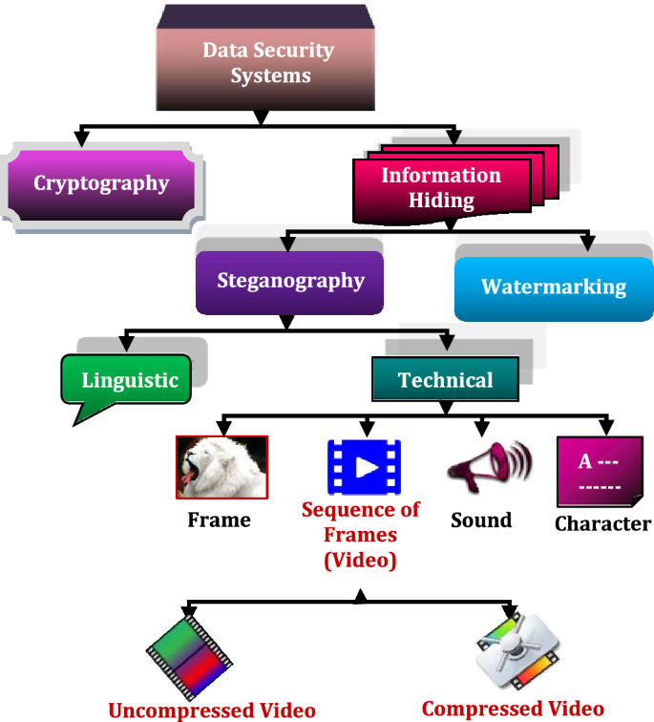
Wow factors
Steganography, derived from the Greek words "steganos" and "graphie, is a fascinating and ancient practice than involves the art and science of concealing information within a seemingly innocuous carriesmedium to ensure its secrecy.
Those are implemented in future:
Digital marking: In the context of cybersecurity and intelligences property
protection,steganography is employed for digital market.To prove in the
authenticate the source,aidin in the prevent of Of authorized use or distribution.
Crytography complement : Steganography can complement crptograhpic method
By adding an extra layer of concealmnt.
Forensic analysis: steganograpy is citical for digital fornsics.To detect hide to the
information Files, it should me helping uncover potential security threats .
Data concealment: cyber attacks often attempt to hide malicious code,malware
Or sentivite information with in files to evade detection.steganography provides
Means to conceal such data,making it challenge for security system to identify
And block malicious actiities.

Slide 6
End users
Secure data hiding in images using steganography is primarily used by organizations like governments, intelligence agencies.This could include hiding confidential documents, classified data, or even secret messages within an image file, making it appear like a regular picture to the naked eye
The below serives used on SECURE DATA HIDING IN IMAGES USING STEGANOGRAPHS
Military intelligence: Sending covert messages to field operatives without raising suspicion.
Law enforcement: Sharing sensitive information during investigations without compromising the source.
Corporate espionage: Exfiltrating sensitive company data without detection.
Digital watermarking: Embedding copyright information or ownership details within images.
The below Who might use steganography:
Government agencies: To transmit classified information securely.
Intelligence organizations: To communicate with agents in the field without detection.
Journalists: To protect sensitive sources by hiding information within images.
Cybersecurity professionals: To embed hidden markers for tracking malicious activity.
Important consideration

Slide 7
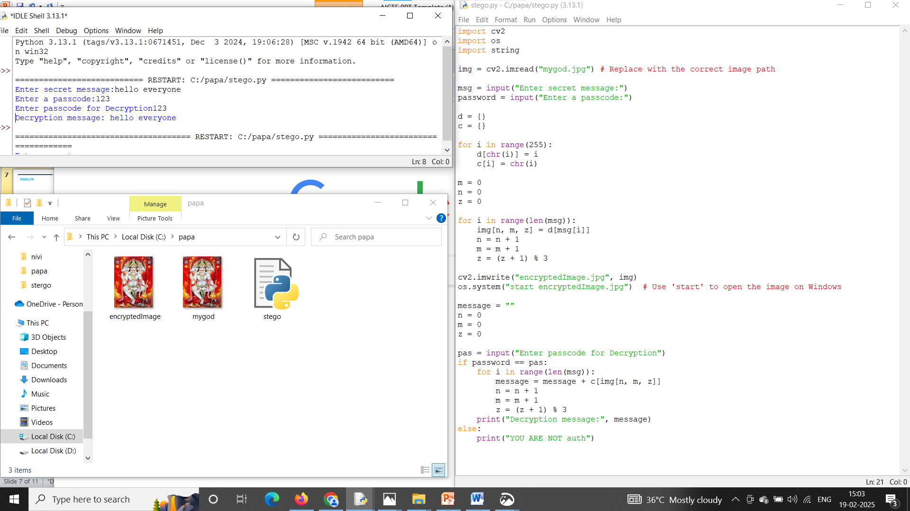
Results

Slide 8
Conclusion
A secure data hiding system using steganography would provide a covert communication channel by embedding sensitive information within seemingly ordinary images. By utilizing advanced encryption techniques and carefully selecting embedding algorithms, the system could achieve a high level of security while maintaining visual quality of the carrier image.

Slide 9
GitHub Link
Read me file must here
Need to run python
Libraries cv2,string
Used pip install cv2
GITHUB: https: https://github.com/niveditha04-yellanuru/CyberSecruity-Internship-Project

Slide 10

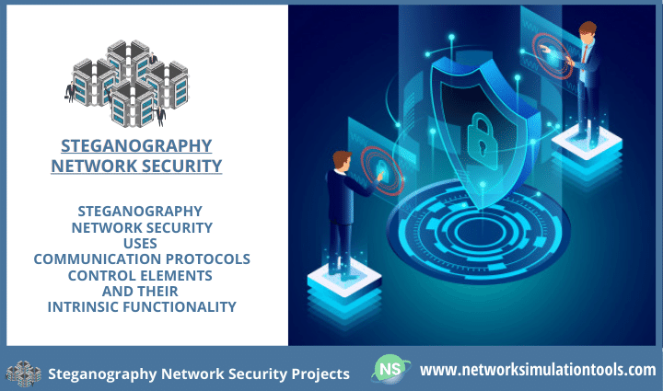

Future scope(optional)
The future scope of secure data hiding in images using steganography lies in developing advanced techniques that leverage emerging technologies like artificial intelligence, blockchain, and quantum computing to achieve greater capacity, robustness against detection, and adaptability to complex image environments, while maintaining high levels of privacy and security for sensitive data, particularly in applications like medical imaging, military intelligence, and secure communication across various platforms.
developing more robust, adaptable, and intelligent algorithms that can effectively hide sensitive information within images while maintaining high imperceptibility and resistance to steganalysis attacks

Slide 11
“It was my pleasure to work with you on this project” THANK YOU

